Slide 1

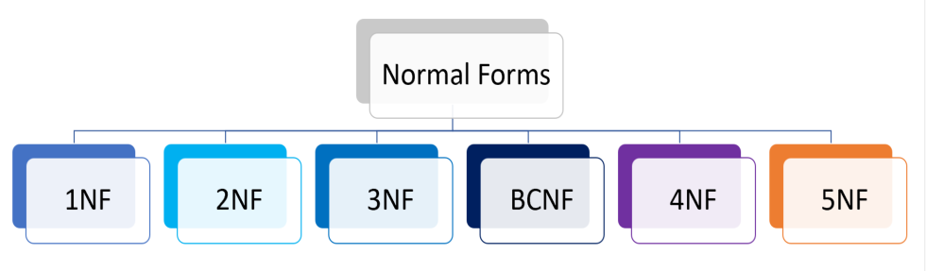
Database Management Systems (BCSC-1003)
Topic: Normalization
Dr. Nikhil Govil
Assistant Professor, Dept. of CEA, GLA University, Mathura.

Slide 2

Normalization
Normalization is a database design technique that reduces data redundancy and eliminates undesirable characteristics like Insertion, Update and Deletion Anomalies.
Normalization rules divides larger tables into smaller tables and links them using relationships.
The purpose of Normalization in SQL is to eliminate redundant (repetitive) data and ensure data is stored logically.

Slide 3
Types of Normal Form
Here is a list of Normal Forms
• 1NF (First Normal Form)
• 2NF (Second Normal Form)
• 3NF (Third Normal Form)
• BCNF (Boyce-Codd Normal Form)
• 4NF (Fourth Normal Form)
• 5NF (Fifth Normal Form)
• 6NF (Sixth Normal Form)

Slide 4
First Normal Form (1NF)
A relation will be in 1NF if it contains an atomic value.
It states that an attribute of a table cannot hold multiple values. It must hold only single-valued attribute.
First normal form disallows the multi-valued attribute, composite attribute, and their combinations.

Slide 5
First Normal Form (1NF)
Example:
Relation EMPLOYEE is not in 1NF because of multi-valued attribute EMP_PHONE.
EMPLOYEE table:
EMP_ID | EMP_NAME | EMP_PHONE | STATE
2925 | RAJESH | 9500407832, 9088170884 | TAMILNADU
6796 | KISHORE | 9510508668 | KARNATAKA
4592 | ALOK | 8455661732 | PUNJAB
3565 | HEMANT | 9759105522, 9414525254 | GUJRAT

Slide 6
First Normal Form (1NF)
The decomposition of the EMPLOYEE table into 1NF has been shown below:
EMP_ID | EMP_NAME | EMP_PHONE | STATE
2925 | RAJESH | 9500407832 | TAMILNADU
2925 | RAJESH | 9088170884 | TAMILNADU
6796 | KISHORE | 9510508668 | KARNATAKA
4592 | ALOK | 8455661732 | PUNJAB
3565 | HEMANT | 9759105522 | GUJRAT
3565 | HEMANT | 9414525254 | GUJRAT

Slide 7
Second Normal Form (2NF)
In the 2NF, relational must be in 1NF.
In the second normal form, all non-key attributes are fully functional dependent on the primary key.
Example:
Let's assume, a college can store the data of teachers and the subjects they teach. In a college, a teacher can teach more than one subject.
TEACHER table:
TEACHER_ID | SUBJECT | TEACHER_AGE
2529 | Information Technology | 30
2529 | Soft Computing | 30
6535 | Data Communication | 45
3578 | Soft Computing | 35
3578 | Digital Image Processing | 35

Slide 8
Second Normal Form (2NF)
In the given table, non-prime attribute TEACHER_AGE is dependent on TEACHER_ID. That's why it violates the rule for 2NF.
To convert the given table into 2NF, we decompose it into two tables:
TEACHER_DETAIL Table and TEACHER_SUBJECT Table:
TEACHER_ID | TEACHER_AGE
2529 | 30
6535 | 45
3578 | 35
TEACHER_ID | SUBJECT
2529 | Information Technology
2529 | Soft Computing
6535 | Data Communication
3578 | Soft Computing
3578 | Digital Image Processing

Slide 9
Third Normal Form (3NF)
A relation will be in 3NF if it is in 2NF and not contain any transitive partial dependency.
3NF is used to reduce the data duplication. It is also used to achieve the data integrity.
If there is no transitive dependency for non-prime attributes, then the relation must be in third normal form.
A relation is in third normal form if it holds at least one of the following conditions for every non-trivial function dependency X → Y.
1. X is a super key.
2. Y is a prime attribute, i.e., each element of Y is part of some candidate key.

Slide 10
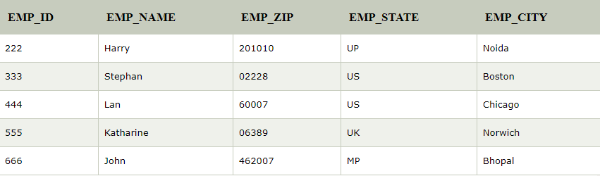
Third Normal Form (3NF)
EMPLOYEE_DETAIL table:
Super key in the table above:
{EMP_ID}, {EMP_ID, EMP_NAME}, {EMP_ID, EMP_NAME, EMP_ZIP}.... so on.
Candidate key: {EMP_ID}
Non-prime attributes: In the given table, all attributes except EMP_ID are non-prime.
Here, EMP_STATE & EMP_CITY dependent on EMP_ZIP and EMP_ZIP dependent on EMP_ID. The non-prime attributes (EMP_STATE, EMP_CITY) transitively dependent on super key (EMP_ID). It violates the rule of third normal form.

Slide 11
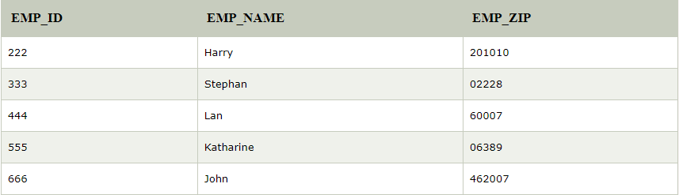

Third Normal Form (3NF)
That's why we need to move the EMP_CITY and EMP_STATE to the new <EMPLOYEE_ZIP> table, with EMP_ZIP as a Primary key.
EMPLOYEE table:
EMPLOYEE_ZIP Table:

Slide 12
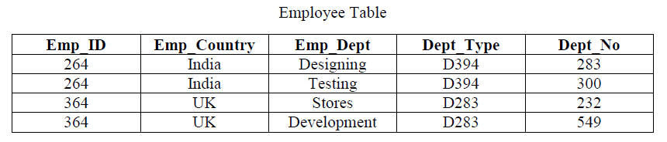
Boyce-Codd Normal Form (BCNF)
BCNF is the advance version of 3NF. It is stricter than 3NF.
A table is in BCNF if every functional dependency X → Y, X is the super key of the table.
For BCNF, the table should be in 3NF, and for every FD, LHS is super key.

Slide 13
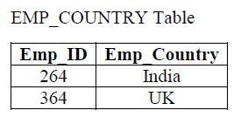
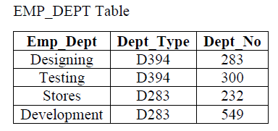
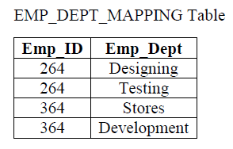
Boyce-Codd Normal Form (BCNF)
In the above table Functional dependencies are as follows:
EMP_ID → EMP_COUNTRY
EMP_DEPT → {DEPT_TYPE, EMP_DEPT_NO}

Slide 14
References
Korth, Silbertz and Sudarshan (1998), “Database Concepts”, 4th Edition, TMH.
Elmasri and Navathe (2010), “Fundamentals of Database Systems”, 5th Edition, Addision Wesley.
Date C J,” An Introduction to Database Systems”, 8th Edition, Addision Wesley.
M. Tamer Oezsu, Patrick Valduriez (2011). “Principles of Distributed Database Systems”, 2nd Edition, Prentice Hall.

Slide 15


